Slide 1

Democracy and How We Measure It
Timea Balogh
University of California, Davis

Slide 2

Democracy
Demos = people
-cracy = “rule”
AKA rule by the people…
Democracy gets its legitimacy from active participation of the ”demos”

Slide 3
Different conceptions of democracy: Procedural
Focus on process and rules that make up governing institutions
Means by which representation, accountability, and legitimacy are assured
How decisions are made, rather than what decisions are made
When we talk about democratization, we usually think about implementing certain democratic processes and rules
Can be minimalist = multi-candidate/party, competitive elections
Or complex = requiring additional institutions or legal liberty protections

Slide 4
Different conceptions of democracy: Procedural
Limitations
Do elections = democracy?
A country may have free and fair elections, but lack rule of law or civil liberties → “illiberal democracies”
Everyone has the right to vote, but human rights or individual liberties are not properly protected
Freedom of the press and media access for opposition parties may be restricted
Political opponents may be imprisoned without due process
Examples: Russia and Nigeria

Slide 5
Different conceptions of democracy: Substantive
Democracy is evaluated based on the political outcomes and their representativeness
Democracy which has competitive, fair elections, as well as full civil liberties and rights
Often considered a consolidated democracy
Elites and citizens have accepted the “rules of democracy”
Rule of law is respected
Examples: UK, US, Canada, Japan

Slide 6

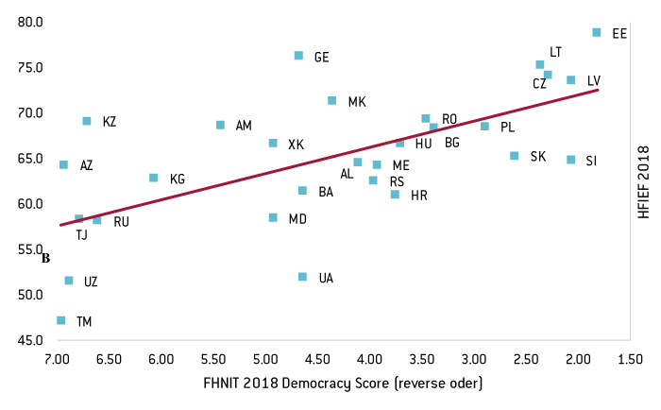
Does democracy mean…
More orderly, stable, peaceful, and consensual than nondemocracy? More equal?
Not necessarily!
More economically prosperous, efficient, capitalistic?
Also not necessarily!
Want to know more? Take POL 174!
Majority rule?
Again, no! ”This is a democracy!” argument is somewhat flawed
All democracies have some means of aggregating the preferences of individuals, but not always majority wins
Think US popular vote and electoral college

Slide 7
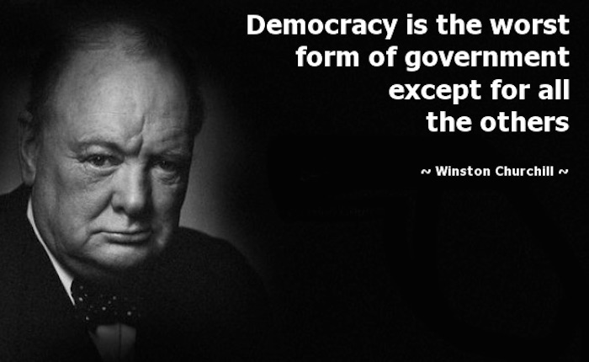

Slide 8
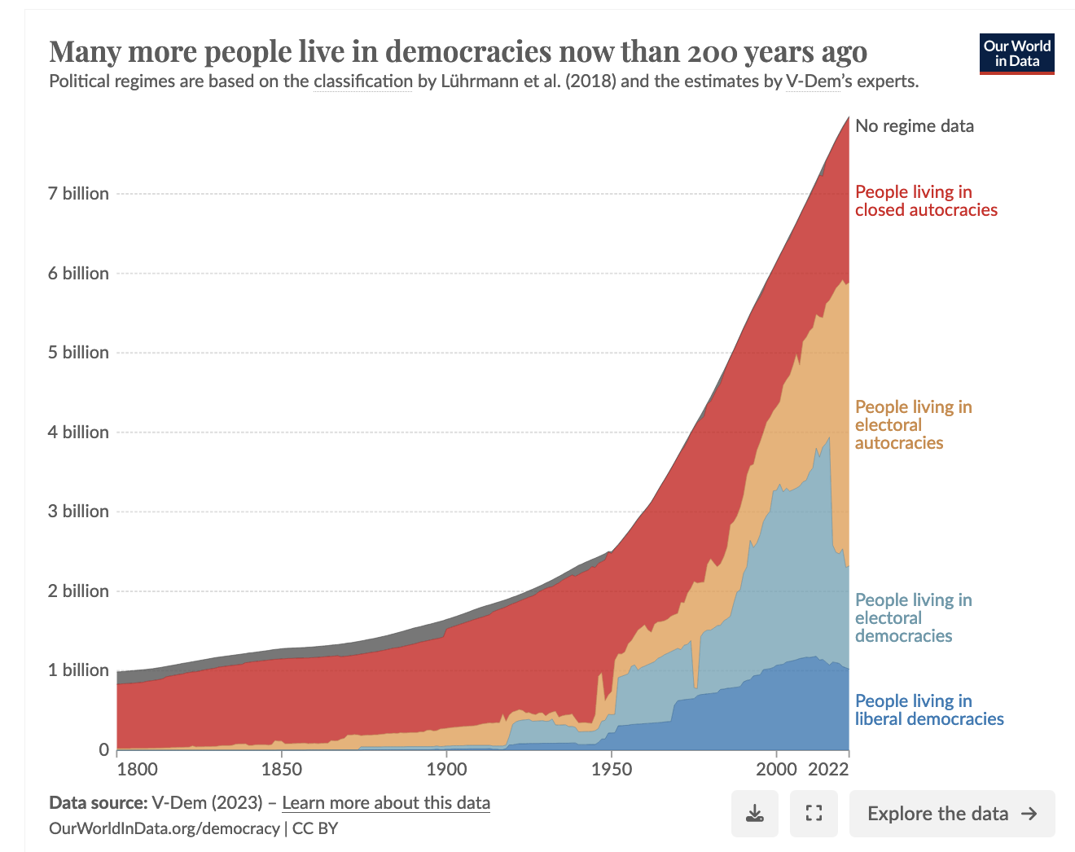

Slide 10
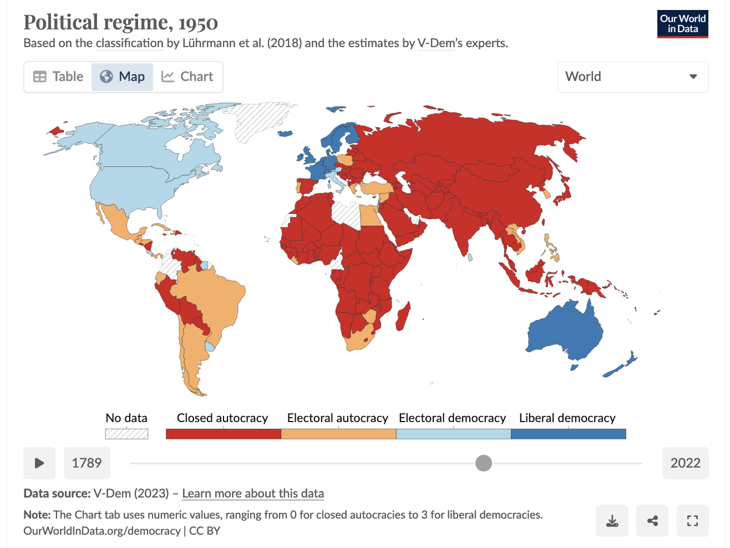
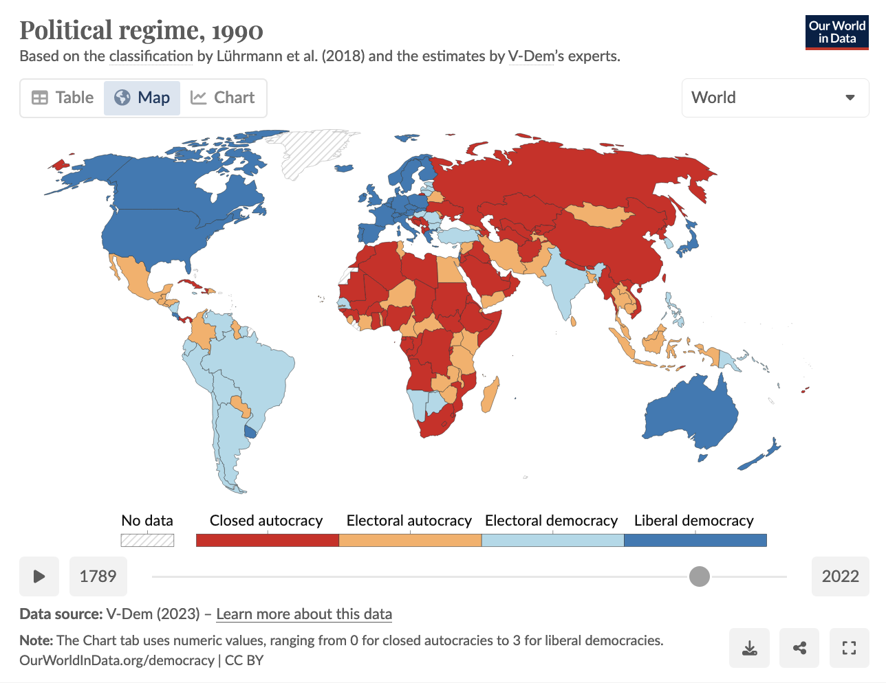
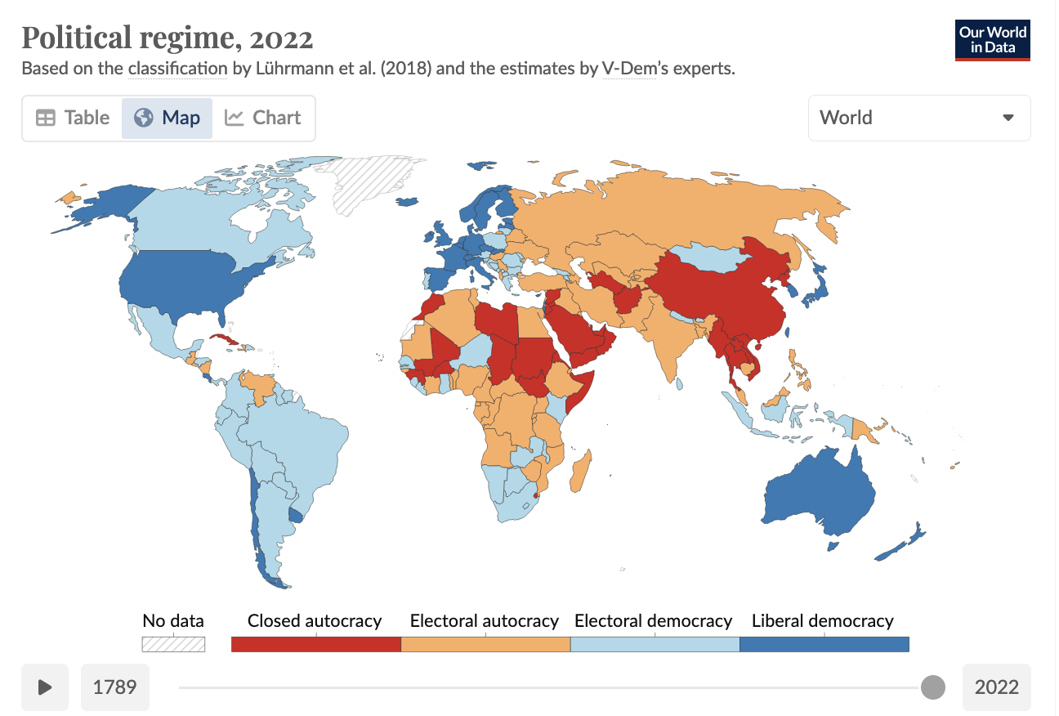

Slide 11
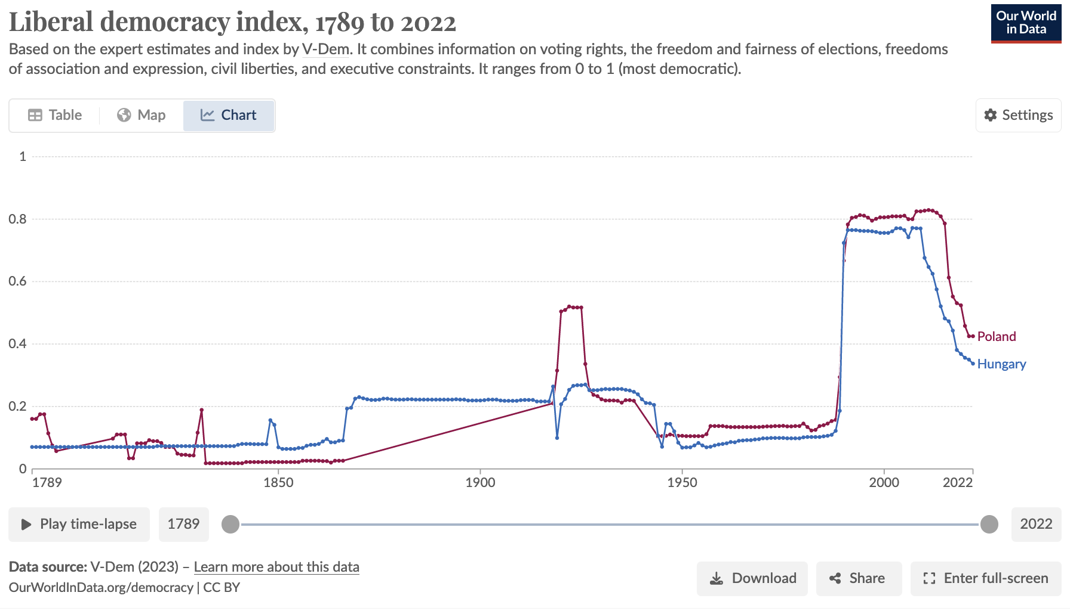
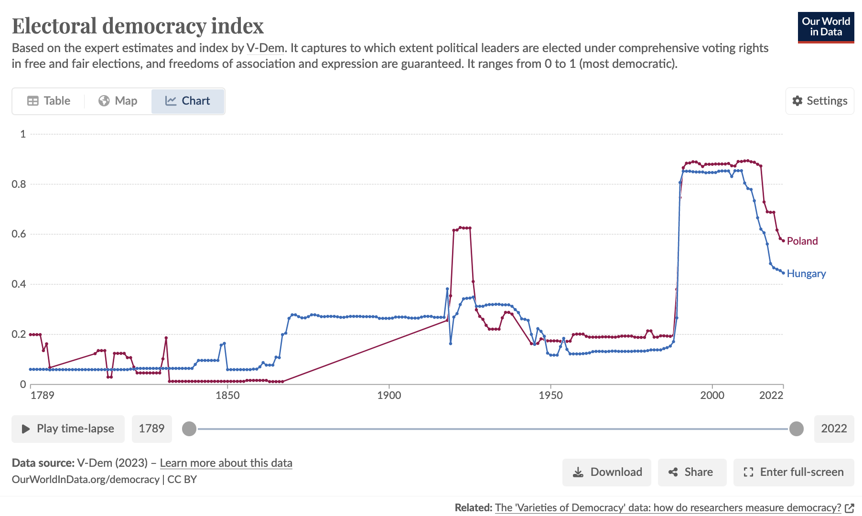
Hungary vs. Poland
Both former communist states that had been occupied by Soviet Union
1989 – communist regime formally abolished, leading to sharp change in political regime
1991 – Soviet military occupation ends
Different outcomes today
Poland has had a less prominent and continuing decline in democracy in recent years than Hungary
Poland’s democracy somewhat stagnant today
As of 2022, according to V-Dem, Poland classified as an electoral democracy, while Hungary classified as electoral autocracy

Slide 12
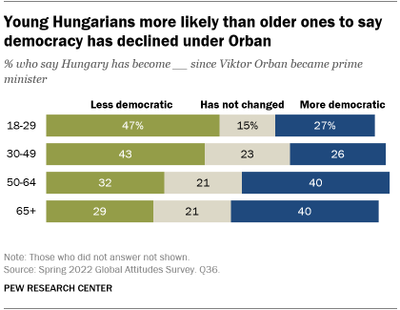
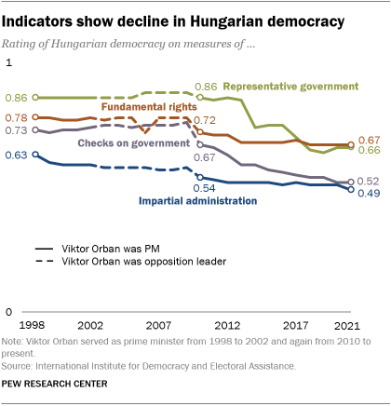
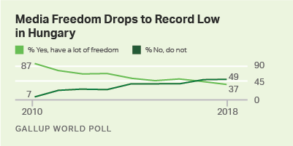
Notes:
What’s the story here?

Slide 13
Why measure democracy?
Researchers and policy makers frequently need information about how democratic countries are, or whether a country is democracies or not
Academics: Need it to test research claims. For example, do countries that are (more) democratic have…
Less war?
More equality?
Greater economic prosperity?
Policymakers: Allocation of aid may be conditional on democratic performance
Objective of policy may also relate to improving democratic indicators, so it needs to be measurable
Key criteria of concept measurement: validity and reliability!

Slide 14
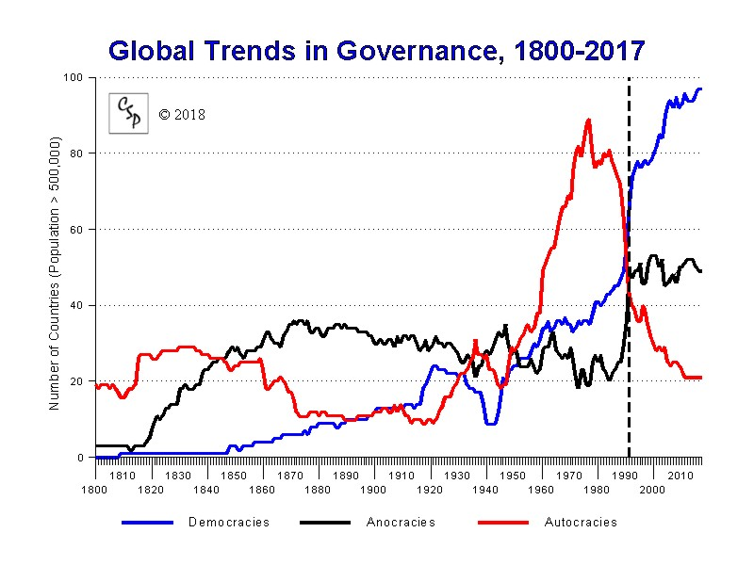
How do different measures score democracy?
Continuous = Not separated by distinct categories (i.e., can be 80% democratic)
Dichotomous = 2 or more distinct values or categories (either is or is not)
Democratization → becoming “more” democratic (continuous) or becoming democratic (dichotomous)?
Democracy Measurement | How they score democracy
Varieties of Democracy (V-Dem) | On a spectrum: 0 (highly undemocratic) to1 (highly democratic)
Polity | On a spectrum: -10 to 10, hereditary monarchy to consolidated democracy Also as a classification: autocracy (-10 to -6) < anocracy (-5 to +5) < democracy (+6 to +10)
Freedom House | As a classification: (1) not free < partly free < free and (2) non-democracy < electoral democracy
Regimes of the World | As a classification: closed autocracy < electoral autocracy < electoral democracy < liberal democracy
Figured based on Polity, where -10 to -6 = autocracy, -5 to +5 = anocracy, +6 to +10 = democracy
Notes:
The "Polity Score" captures this regime authority spectrum on a 21-pont scale ranging from -10 (hereditary monarchy) to +10 (consolidated democracy). The Polity scores can also be converted into regime categories in a suggested three part categorization of "autocracies" (-10 to -6), "anocracies" (-5 to +5 and three special values: -66, -77 and -88), and "democracies" (+6 to +10).

Slide 15
Conceptualizing and measuring democracy
Do we measure democracy in a narrow or a broader sense?
Narrow
Are the basic principles of democracy met?
Is the electoral political system is one in which citizens get to participate in free and fair elections?
Is it ”liberal” so citizens have additional civil rights and are protected from the state?
Is there media freedom to allow citizens to make decisions?
Broader (in addition to basic principles…)
Is it participatory and deliberative?
Citizens should be engaging in elections, civil society should be active
Public discourse should be unrestrained
Is it effective?
Government should be able to successfully act on citizens’ behalf

Slide 16
How fine-grained is the measurement?
Democracy Measurement | How fine-grained is the measurement?
Varieties of Democracy (V-Dem) | Captures big to very small differences
Polity | Captures big to medium differences
Freedom House | Captures big differences
Regimes of the World | Captures big differences
Notes:
Fine-grained measurements capture both big and small differences, such as the level of democratic quality between democracies in Chile and Norway, as well as the differences between autocracies like North Korea and Suadi Arabia
Spectrums are better at capturing these smaller changes within political systems over time, changes away from or towards democracy

Slide 17
How are democracy’s characteristics assessed?
Democracy Measurement | How are democracy’s characteristics assessed?
Varieties of Democracy (V-Dem) | Mostly through evaluations by experts. Then weighted for sub characteristics.
Polity | Mostly through evaluations by researchers themselves (based on academic literature and news reports). Then weighted for sub characteristics.
Freedom House | Mostly through evaluations by country and regional experts and researchers themselves (based on different sources). Then weighted for sub characteristics and whether necessary characteristics are present or not.
Regimes of the World | Mostly through evaluations by experts, some easy-to-observe characteristics evaluated by researchers themselves. Then weighted for sub characteristics and whether necessary characteristics are present or not.
Notes:
Weighting and how it is done can make a huge difference!
Weighting essentially means putting more emphasis on different dimensions of democracy. Some dimensions may contribute less to the overall classification as democracy or not, or the level of democracy, than other dimensions.
Which dimensions are weighted more heavily in an index is fundamentally still a subjective decision

Slide 18
How are measurements made to be precise and accurate?
Democracy Measurement | How do they make evaluations precise and accurate across experts/researchers?
Varieties of Democracy (V-Dem) | 5 or more experts per country, year, and characteristic, often 25 per country
Polity | Several researchers used
Freedom House | More than 100 experts and researchers used Rely on lots of different sources, including academic research, news, NGO reports, personal conversations, and on-the-ground research
Regimes of the World | 5 or more experts per country, year, and characteristic, often 25 per country

Slide 19
Conceptual Overloading?
The Freedom House Index has been criticized for overloading the concept of democracy with a bunch of characteristics that are really capturing political liberalism, social justice, and security (Schneider and Schmitter 2004)
Other times measures are criticized for demanding ”too little” of democracy, ignoring the different degrees to which electoral participation and party competition effectively render political leaders accountable to citizens
Different measures = different conceptualization.
Freedom House, for example, does not account for executive restraint in its democracy scoring, while Polity weighs executive restraint heavily in its score

Slide 20

Builds on Robert Dahls’ concept of polyarchy
2 dimensions are necessary for democratic government: high levels of political participation (inclusiveness) and political contestation (liberalization)
More realistic and attainable than “ideal democracy”
Elected officials
Free and fair elections
Inclusive suffrage (right to vote)
Right to run for public office (and compete for votes)
Freedom of expression
Alternative sources of information (essentially media/press freedom)
Associational autonomy (freedom to join associations, including parties)

Slide 21
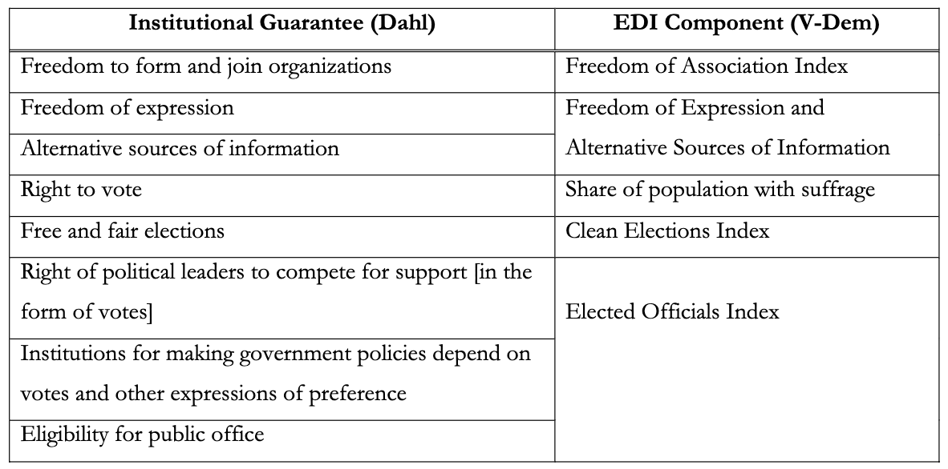
V-Dem’s Electoral Democracy Index (EDI) and Polyarchy

Slide 22
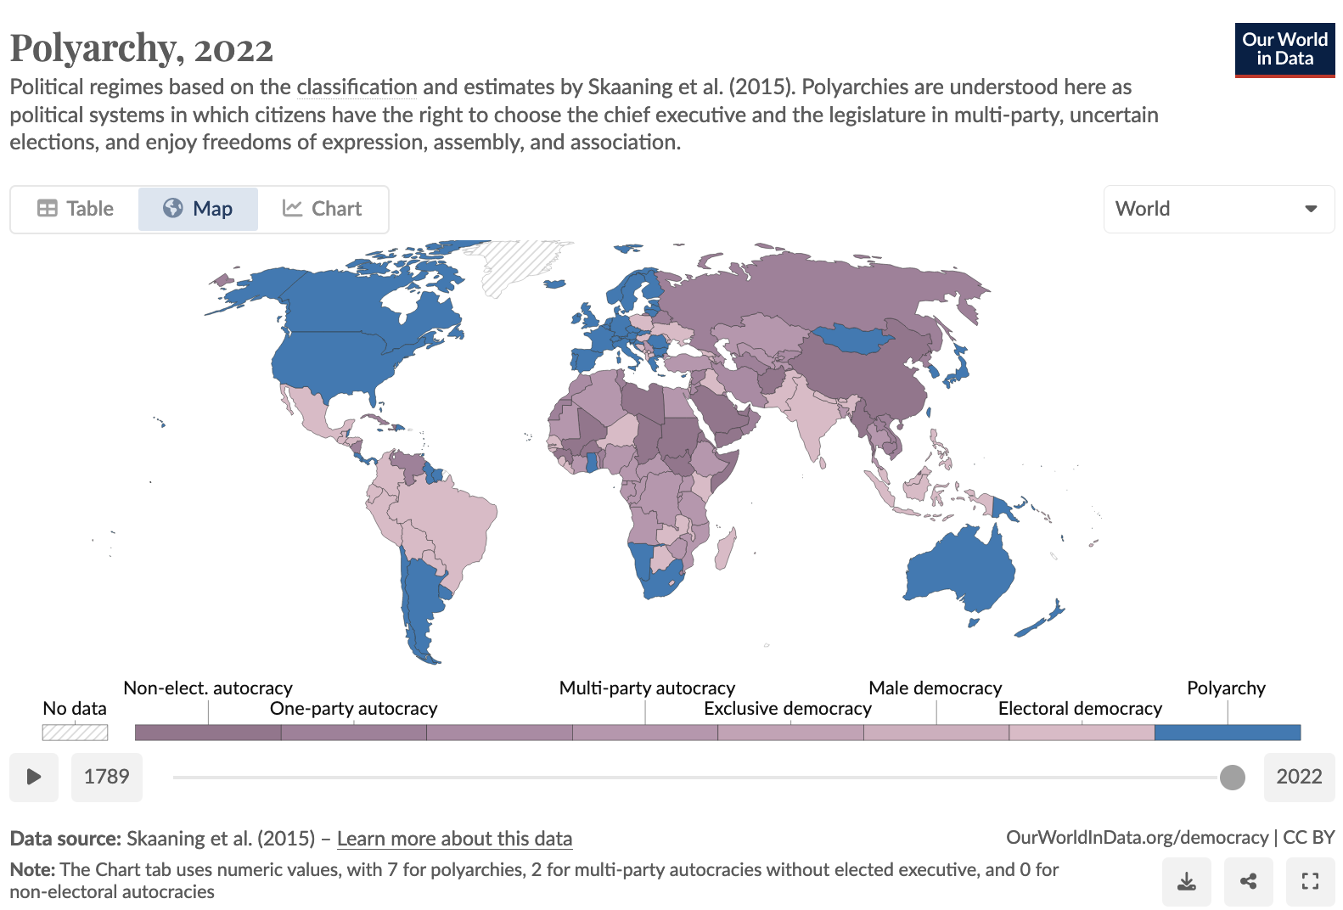
Political Regime Classifications
V-Dem Polyarchy regime classification based on “Lexical Index of Electoral Democracy”
0: Non-electoral autocracy: Where citizens do not have the right to elect the chief executive or the legislature
3: Multi-party autocracy: Citizens have more than one choice, but election outcome is certain
6: Electoral democracies: mature democracies that have comprehensive suffrage for all
7: Polyarchy: electoral democracies that also protect the freedoms of expression, assembly, and association

Slide 23
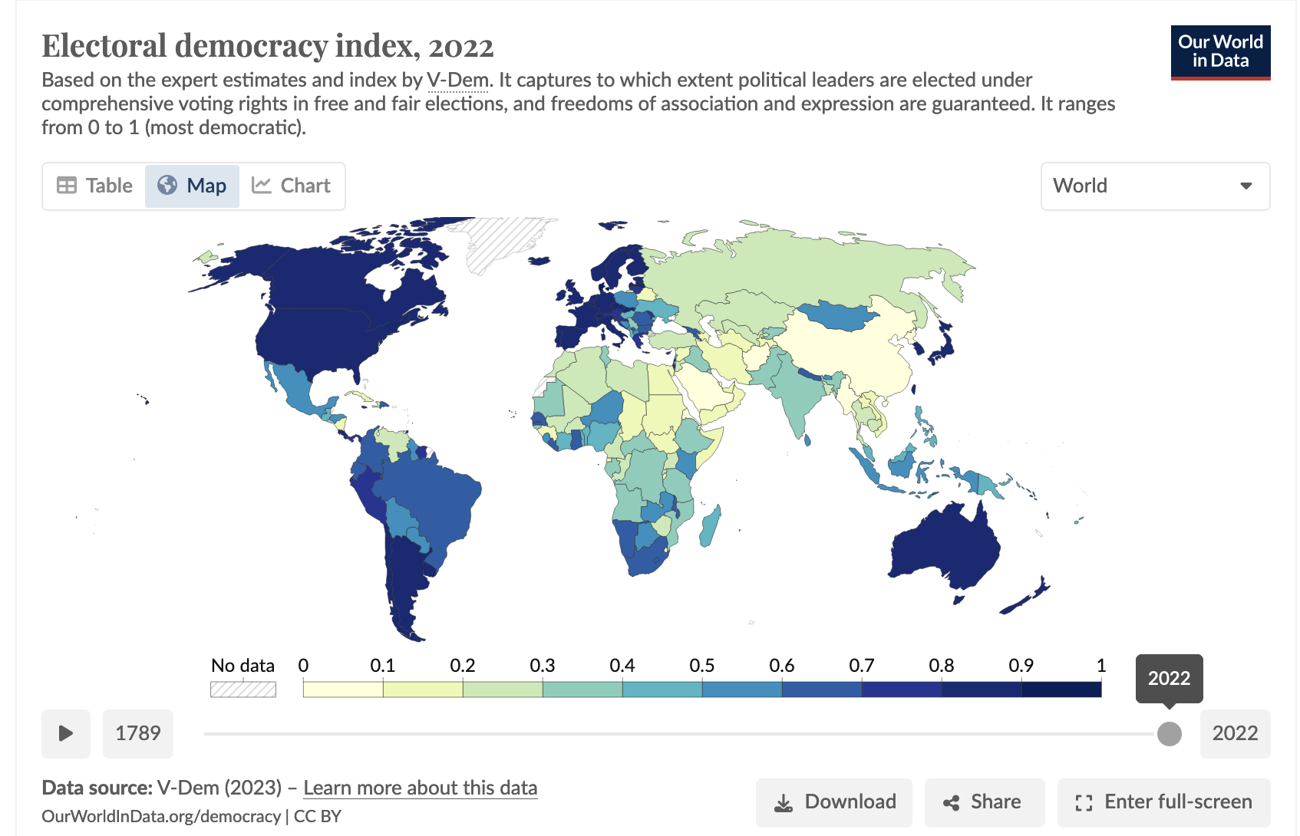
V-Dem’s Electoral Democracy Index

Slide 24
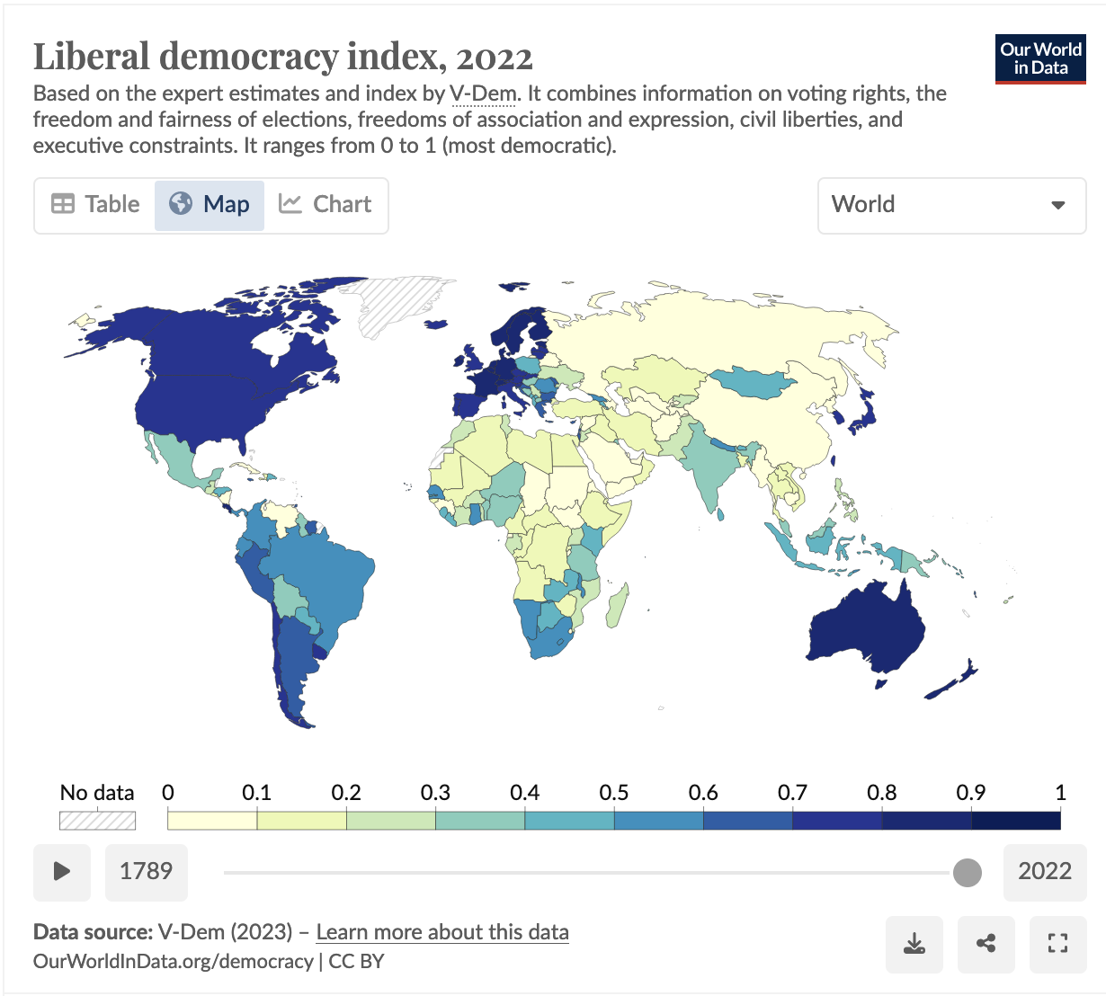
V-Dem’s Liberal Democracy Index

Slide 25
Let’s compare. Notice any differences in scores for liberal democracy vs. electoral democracy?

Slide 26
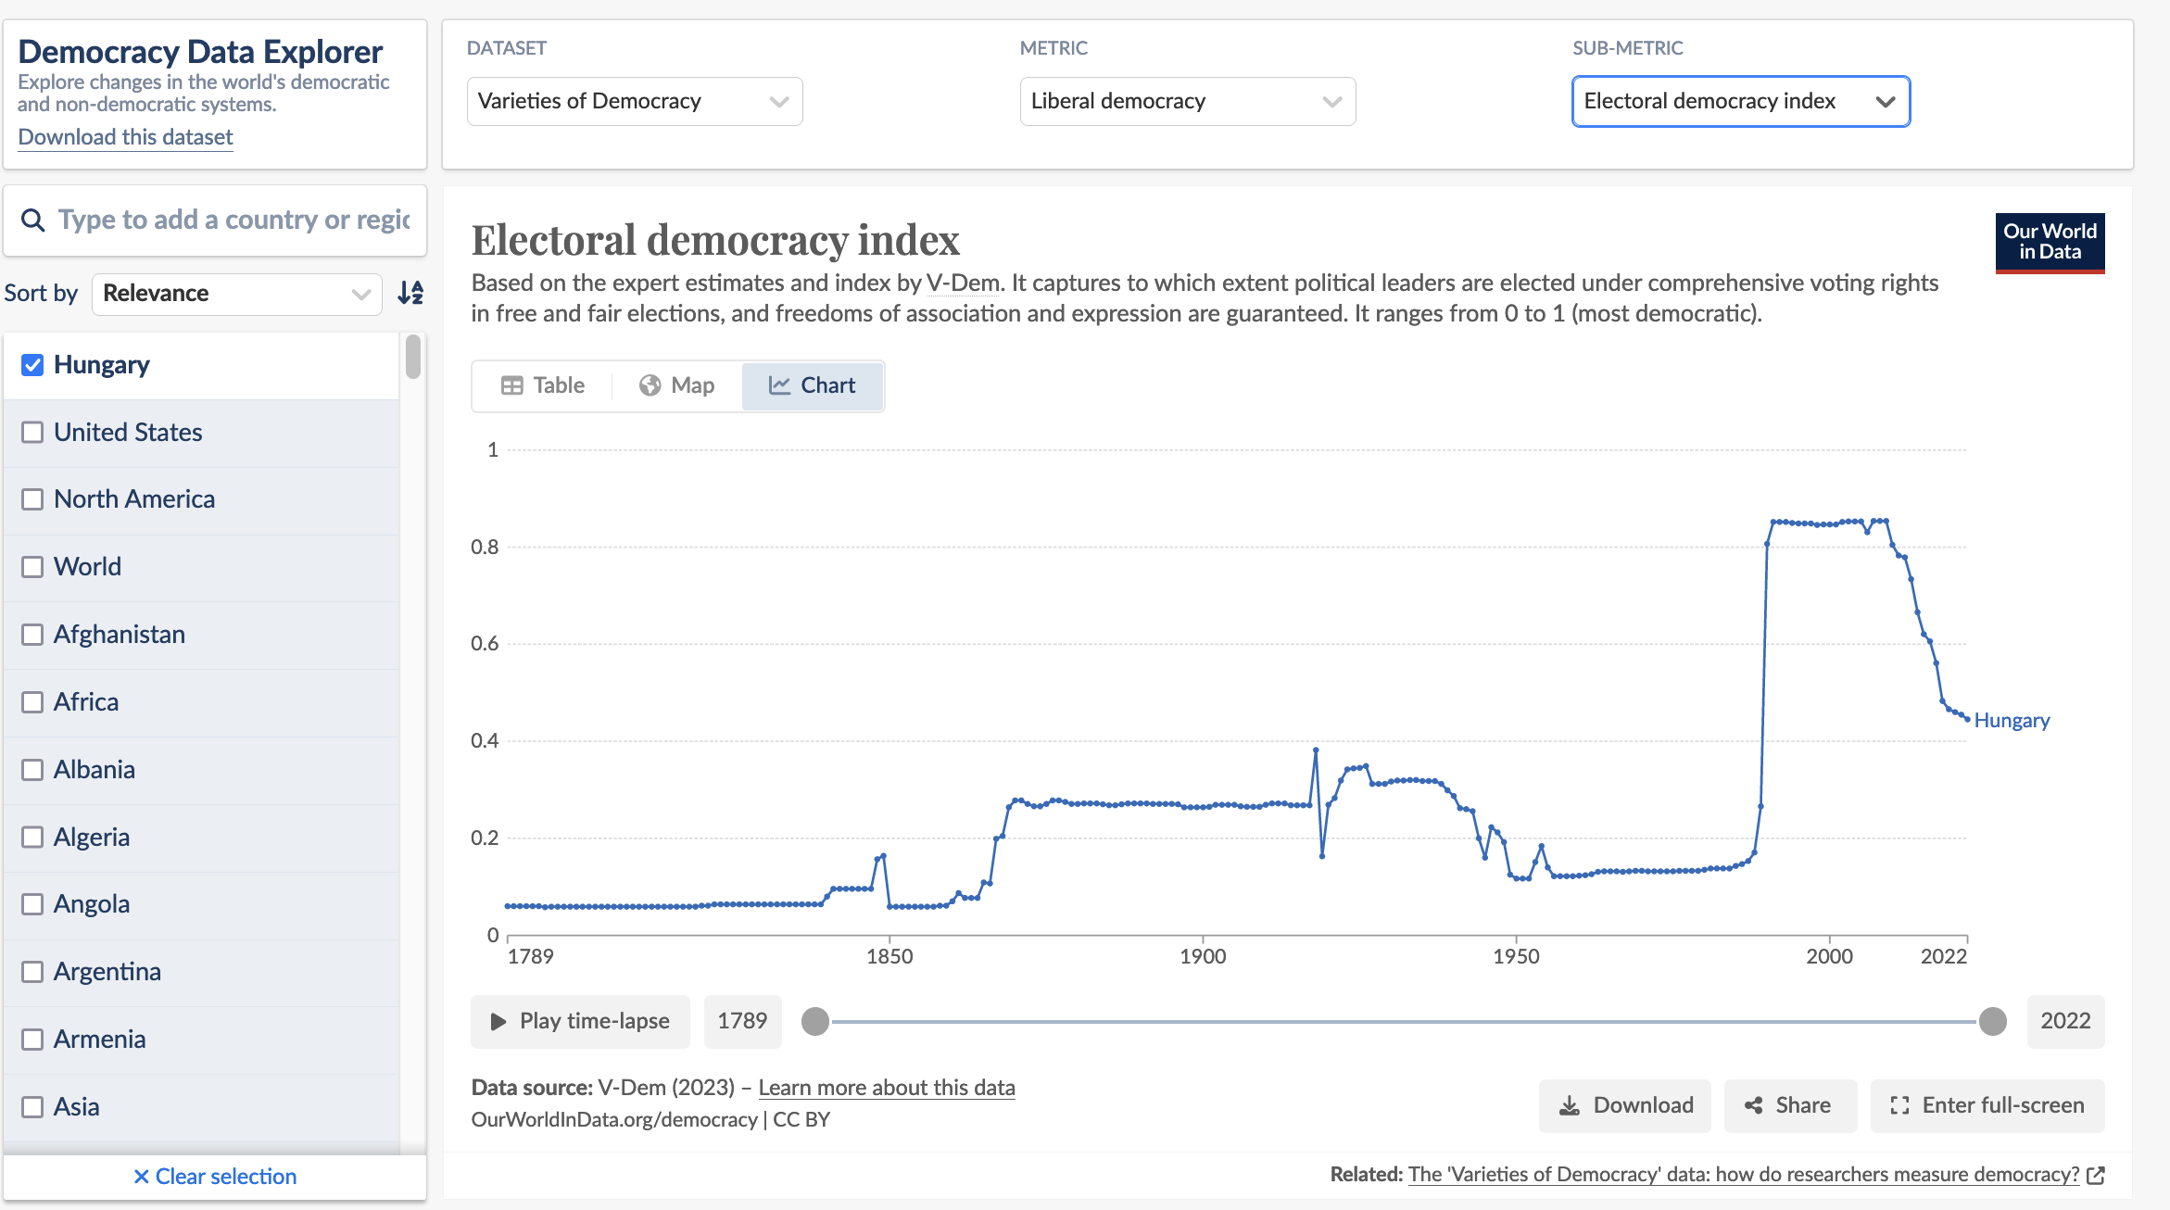
V-Dem Activity
Get into pairs and pick a country that is of interest to both of you!
Follow this link: https://ourworldindata.org/democracy#explore-data-on-democracy
Restrict to only your country in the left-hand menu
Select “Dataset” = “Varieties of Democracy” at the top
Explore different metrics and sub metrics for your country
You can compare metrics with another country by selecting a 2nd country in the left-hand menu (try comparing with US!)

Slide 27
V-Dem Activity
What is your main observation about the level of democracy in your country today?
Are there differences if you look at “electoral democracy” versus “liberal democracy”?
What is the main trend over time when it comes to the level of democracy in your country?
Has it changed a lot over time?
If so, are most of the changes recent or older?
Are the changes positive (democratization) or negative (democratic backsliding)?
Compared to another country, what are some similarities or differences in the characteristics of democracy in your country? For example, one country may be stronger in one metric than another.
What is something that surprised you about the metrics you found?

Slide 28
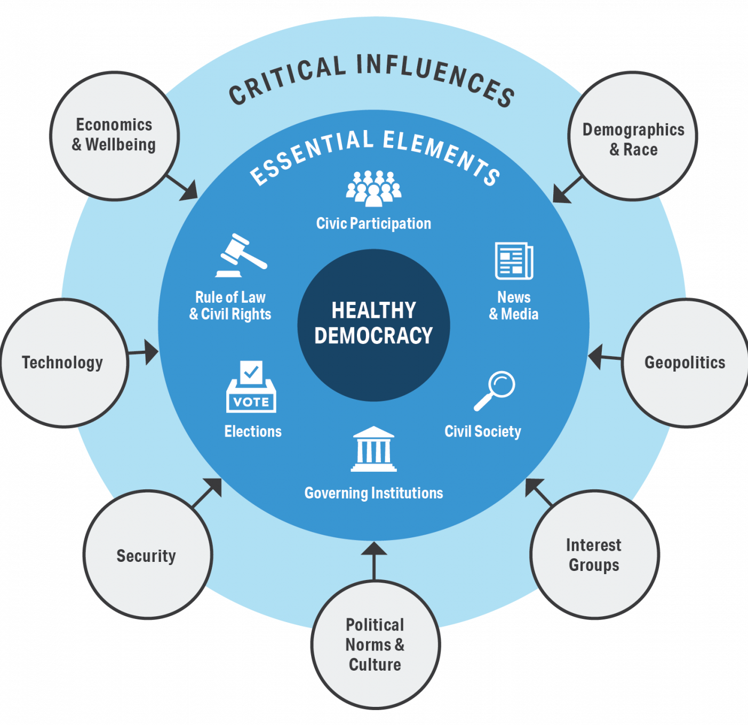
Summary
Democracy gets its legitimacy from active participation of the ”demos”
Different conceptions of democracy emphasize procedural or substantive aspects → both are generally important!
We measure democracy so we can study its causes and consequences!
Every measure does things a little differently

